Slide 1
Student Attendance Management System
A Smart Attendance Management App

Slide 2
Introduction
The Student Attendance Management System is a comprehensive and user-friendly application designed to streamline and digitize the process of tracking student attendance. The system supports three types of users: Admin, Teacher, and Student, each with distinct roles and access levels. Admins have full control over the system, managing user access, course data, and overall system settings. Teachers can take daily attendance, view their schedules, edit their profiles, and update attendance records when necessary. Students can conveniently monitor their attendance status based on individual courses. This system not only improves the accuracy and efficiency of attendance tracking but also enhances transparency and communication between students and faculty.

Slide 3
System Dashboard
Admin
Admin Has dedicated login section and functionalities.
Teacher
Every teacher can login using their own identities and new ones can register as well .They also have their specific functionalities.
Student
Student’s login system is similar to teacher’s login system but then can only see their course and watch attendance reports.

Slide 4
Admin role in the system
The Admin is the central authority in the Student Attendance Management System. They have full control and access to all modules, ensuring smooth operation and data integrity across the platform.
Key Responsibilities:
👥 Manage Users: Add, update, or remove student and teacher accounts.
📚 Course Management: Create and assign courses to teachers and students.
📅 Schedule Management: Set and modify class schedules efficiently.
📊 View Reports: Generate and view detailed attendance reports and summaries.
🛠 System Settings: Configure and maintain app settings and access controls.
The Admin dashboard provides a powerful interface to oversee the entire academic structure, making administration more efficient and less time-consuming.

Slide 5
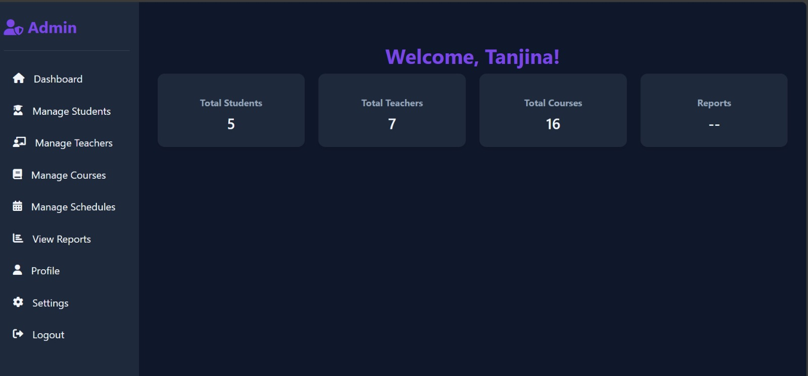
Admin DAshboard
Admin manages teacher’s, student’s, courses and schedules .He can also view Reports as well .

Slide 6
TeachERS ROLE IN THE SYSTEM
Teachers play a vital role in managing class-level attendance and interacting with their assigned courses through the system.
Key Features:
✅ Take Attendance: Mark and submit student attendance for each class.
📅 View Schedule: Access and manage their class schedules.
✏️ Edit Attendance: Modify or correct attendance records when necessary.
👤 Edit Profile: Update personal and professional information.
📈 Monitor Class Records: Track attendance patterns for each course.

Slide 7
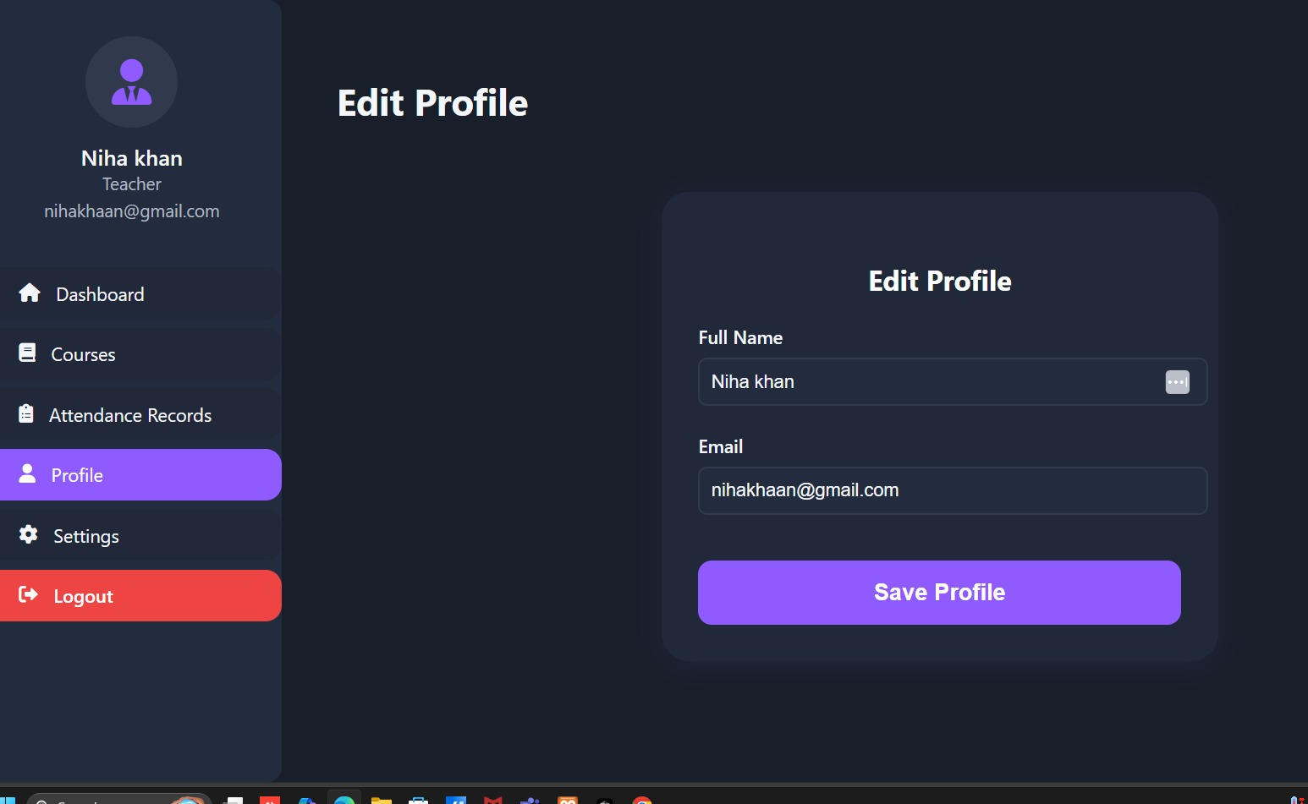
Teachers Dashboard
Teacher can see the courses which he has taken and manage Attendance records.

Slide 8
Student role in the system
Students use the system to stay informed about their attendance and class participation.
Key Features:
👁 View Attendance: Track attendance status for each course in real time.
📚 Course-wise Breakdown: Check detailed attendance data sorted by subjects.
👤 Student Profile: View and manage their profile information.

Slide 9
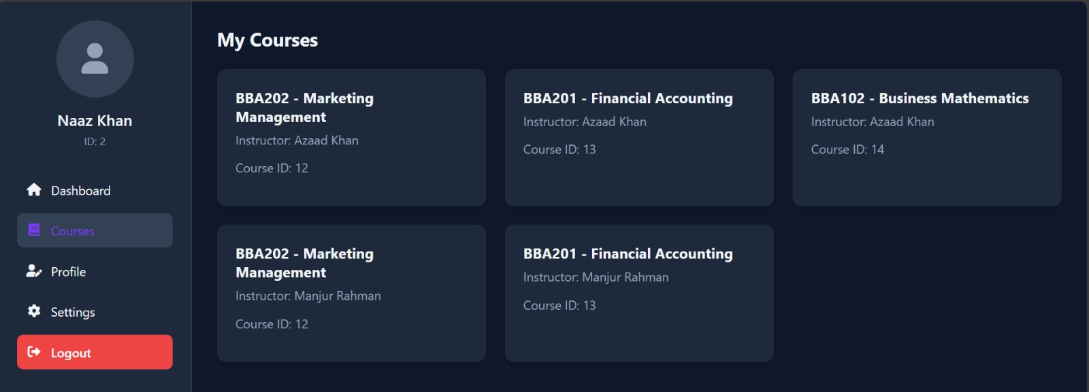
Student Dashboard
Student can watch their courses and reports.

Slide 10
Developer’s word
There are many more functionalities and features which are smart and secure attendance tracking and analyze in style.

Slide 11
Conclusion
the Student Attendance Management System offers a modern and efficient solution to the traditional methods of attendance tracking. By providing distinct functionalities for admins, teachers, and students, the app ensures clarity, accountability, and ease of use for all stakeholders. With features like real-time attendance updates, schedule management, and secure access control, the system contributes significantly to the smooth operation of academic institutions. It empowers educators and students alike by promoting better attendance habits and providing actionable insights into classroom participation.

